Slide 1


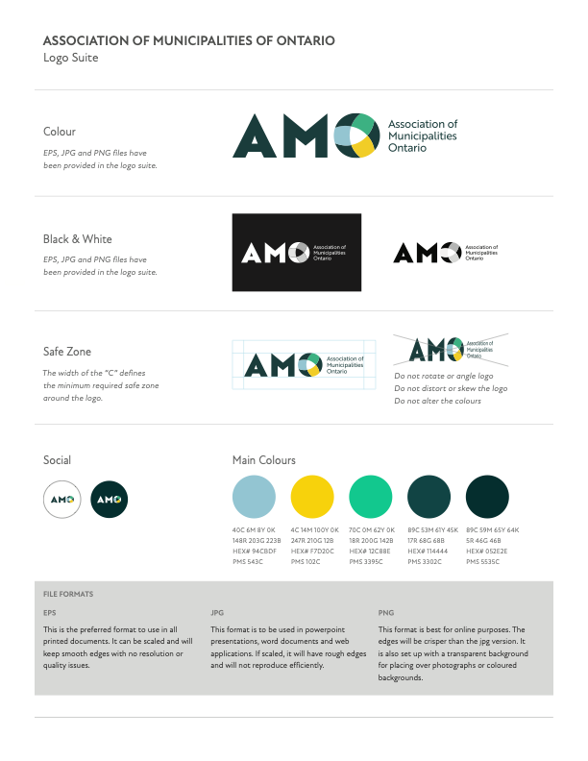

Asset Management Orientation
Toolkit for Members of Council

Slide 2
How to Use this Slide Deck
These slides are intended to support municipal staff in communicating with members of Council about asset management. You can use the deck as is (customizing slides as necessary), or you can select slides and include them in your own decks.
NOTE: there are several slides in this deck that are included as templates that need your info to complete them. Before presenting this deck, add your own content to slide 6 and all the relevant slides in the section called “Working Slides for Municipal Staff” (at the end of this deck).
If you are not going to use the customizable templates, delete them before sharing this deck.

Slide 3

Overview
Why Asset Management Matters
Principles of Asset Management
Key Elements of Asset Management
Roles and Responsibilities of Key Stakeholders
Overview of the Ontario Regulatory Context
Example Case Studies
Working Slides for Municipal Staff:
  Tips for Developing your own Case Study
  State of Infrastructure Template

Slide 4


Why Asset Management Matters
Why Asset Management Matters

Slide 5
Why Asset Management Matters
Asset management provides members of Council with the confidence to make informed decisions about asset investments service levels, risks, and long-term financial sustainability.
To make these decisions with confidence, there are a few key things that members of Council need to know:
  What assets do you own or operate?
  What services are residents expecting?
  What is the current state of the infrastructure (and can it provide these services)?
  What are the costs associated with maintaining the assets and providing these services, (and can we afford it)?
Notes:
A solid understanding of asset management fundamentals will support Council members as they navigate these decisions by relying on an evidence based, data-driven decision-making framework for identifying and addressing asset investment priorities.

Slide 6

Why Asset Management Matters
At its core, asset management is about sustainable service delivery—providing services today in a way that ensures they can continue to be delivered in the future without placing undue financial, operational, social, or environmental burdens on future generations.
In Ontario, asset management planning is a regulatory requirement for all municipalities under O. Reg. 588/17: Asset Management Planning for Municipal Infrastructure.
Asset management is not just a one-time exercise, but is the foundation for defensible decision-making, and an important complement to the budgeting and long-term financial planning processes.
Common municipal infrastructure assets

Slide 7

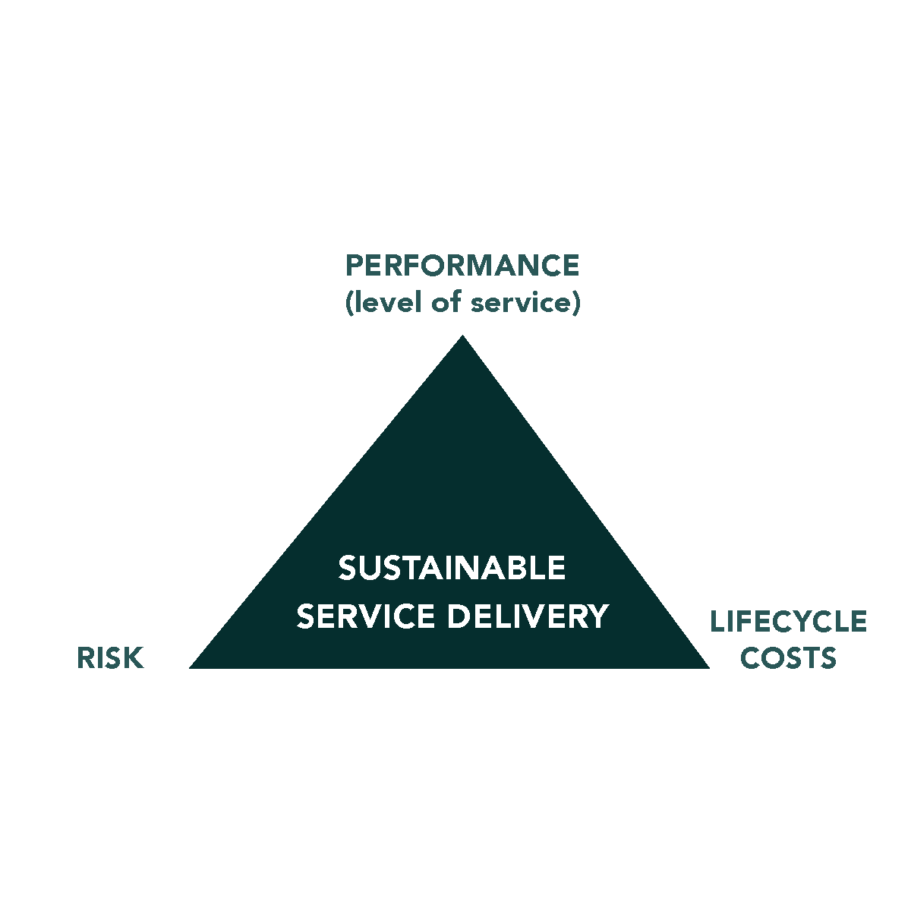
Why Asset Management Matters
Sustainable service delivery =
balancing performance, affordability,
and risks over the long term.
Recommended Actions
for Members of Council:
Familiarize yourself with your municipality’s key asset management related documents, including:
  Strategic asset management policy
  Asset management plan(s)
  Other relevant local plans and documents
Use asset management information to support informed decisions that balance performance, costs, and risks over the long term.

Slide 8
Links to Key Asset Management Documents [users should add their own links to this slide]
Why Asset Management Matters
Strategic Asset Management Policy:
Asset Management Plan:
Annual Progress Update:
Other asset management info?
Annual budget:
Long-term financial strategy:
Strategic Plan:
Official Plan:
Notes:
This is a working slide for municipal staff. Add links to your own relevant documents, or delete this slide.

Slide 9

Principles of Asset Management

Slide 10
Principles of Asset Management
Value: Assets provide value by enabling community services; this “value” goes beyond
financial to encompass everything that is important to a municipality.
Alignment: Asset management helps to create alignment within an organization, ensuring that strategic priorities and community goals are incorporated into all municipal plans and activities.
Leadership: Strong leadership from Council sets the stage for strong asset management.
Assurance: Asset management gives assurance that assets will fulfill their required purpose.
Progress: Asset management is a journey of continuous improvement and incremental progress.

Slide 11

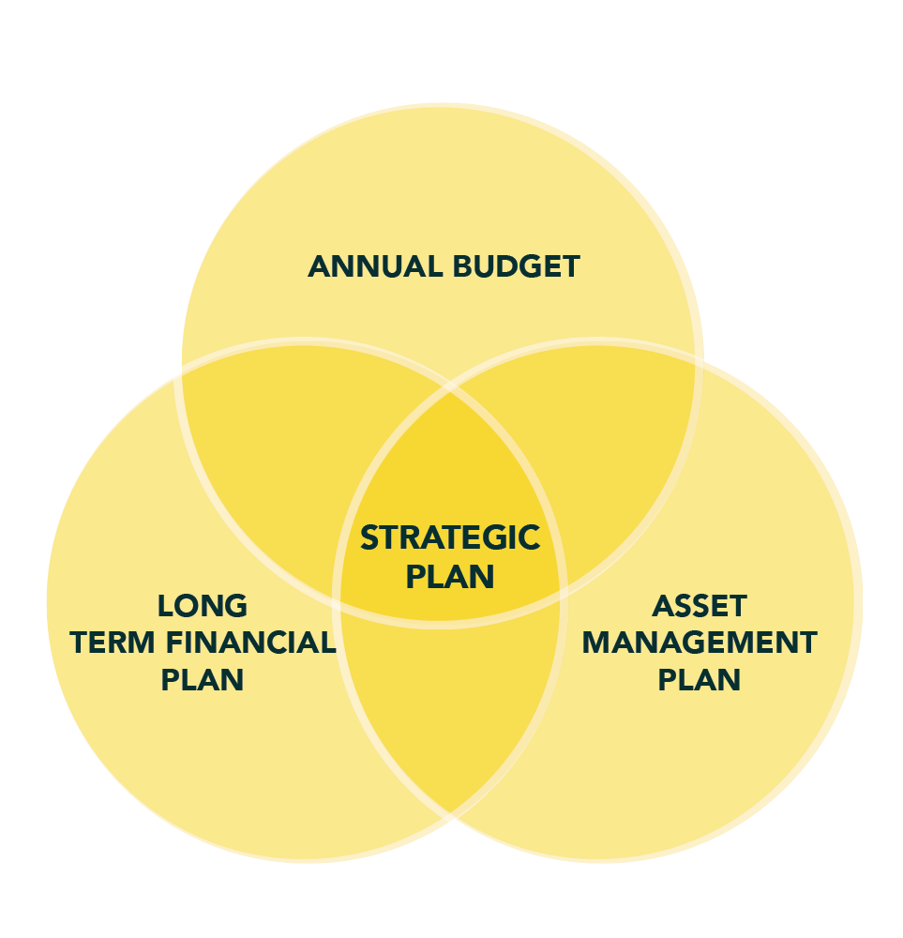
Principles of Asset Management
Recommended Actions
for Members of Council:
Understand these asset management principles and champion asset management in your municipality by:
  Increasing your asset management understanding and awareness through review of existing Plans and Policies
  Investing in asset management (build internal capacity)
  Supporting asset management training or professional development
Support alignment by promoting integration between asset management planning, budget processes, and long-term
financial planning.
Request regular asset management progress updates
(required annually).
Ensure asset management is used for effective decision-making rather than simply a compliance document.
Alignment supports cohesion between
key plans and the annual budget

Slide 12

Key Elements of Asset Management

Slide 13
Key Elements of Asset Management
People & Governance: Who is involved and what governance structure best aligns to
your current business practices?
Asset Information and Data: What assets do we own and what condition are they in?
How is our asset data collected, where is it stored, and who is responsible for maintaining the data?
Levels of Service: What service outcomes are expected by the community?
Risk Management: What impacts asset performance and what happens if assets fail
or performance declines? How can we mitigate the risk of asset failure?
Lifecycle Planning and Financial Strategy: How do decisions today affect our assets
and services over time? What funding is needed over time?
Notes:
Asset management is built on key elements that work together to support sustainable service delivery. The bulk of this work is undertaken by staff, but it is critical that members of Council also understand these elements in order to be able to provide strong leadership and direction.
Together, these elements provide a comprehensive picture of the state of local infrastructure, giving Council the information needed to make informed, evidence-based decisions about service delivery, investment, and long-term sustainability.

Slide 14

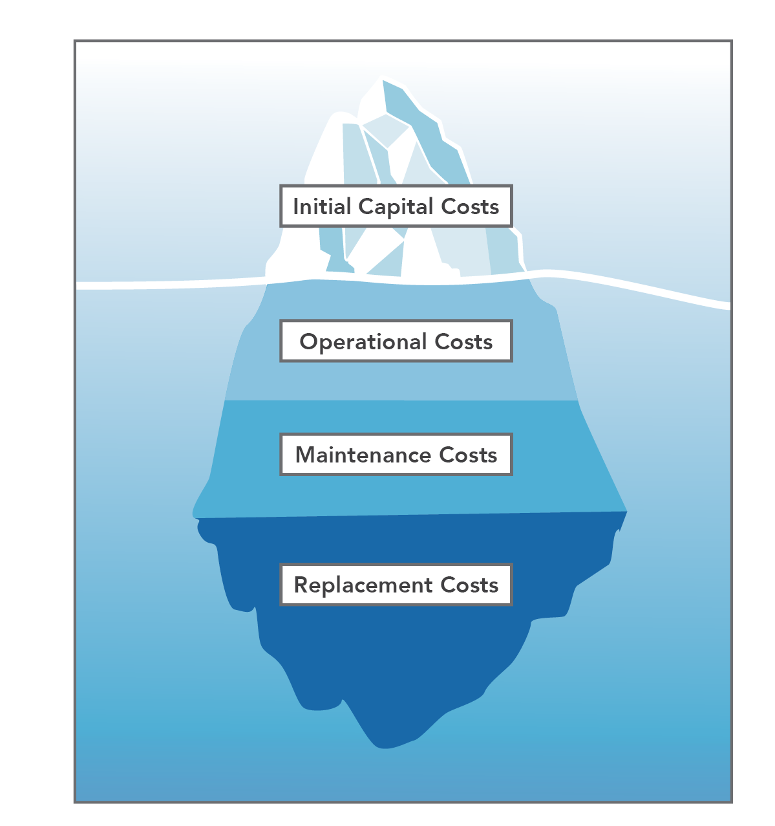
Key Elements of Asset Management
Recommended Actions
for Members of Council:
Ask for regular updates on the state of infrastructure (these updates can be included in the annual progress report required by O. Reg. 588/17)
Proactively set and communicate levels of service by:
  Understanding current levels of service targets & how these were set
  Talking to residents about these level of service expectations (and trade-offs) when necessary
  Using levels of service data and analysis to make decisions

Slide 15

Roles and Responsibilities of Key Stakeholders

Slide 16
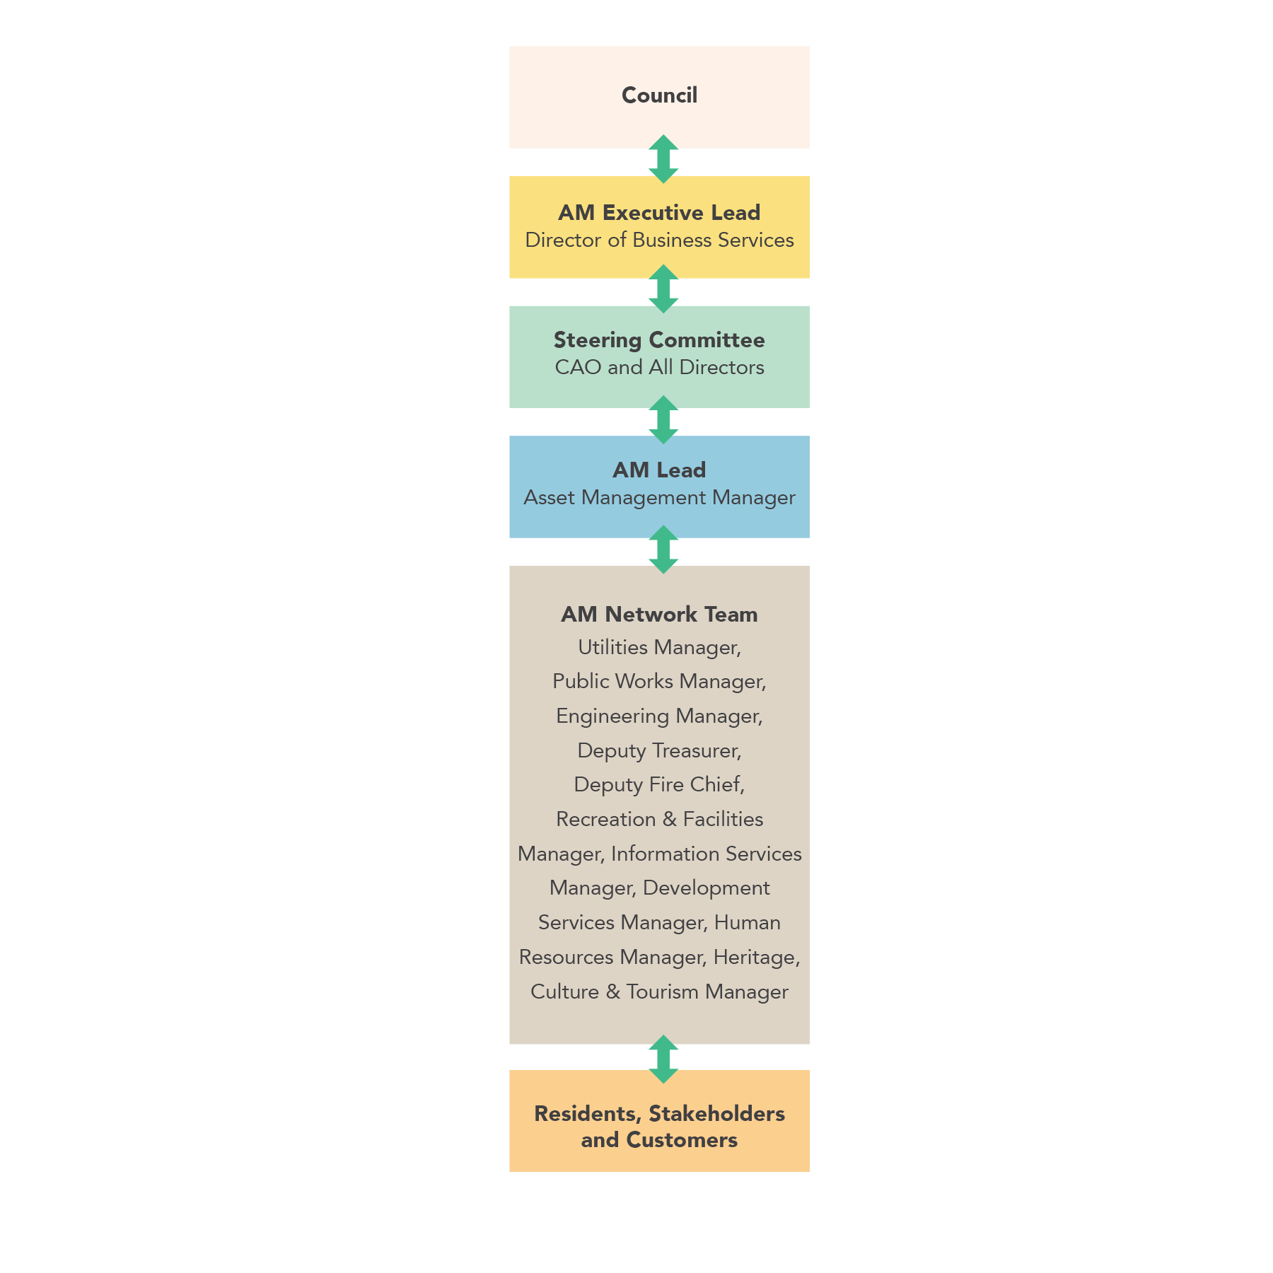
Roles and Responsibilities of Key Stakeholders
Council: Council provides strategic direction, oversight and approvals. This includes approving asset management policies and plans, setting service levels, and making decisions about infrastructure investments and funding. Council plays a critical role in balancing community expectations with financial constraints.
Residents: Residents influence asset management through their expectations, feedback, and willingness to pay for services. Public engagement helps define acceptable levels of service and informs priorities.
Notes:
Asset management is a team sport with shared responsibilities among Council, the CAO / City Manager, staff, and residents; each play a distinct role in supporting effective service delivery and decision-making. Key stakeholders play the following roles:
Council: Council provides strategic direction, oversight and approvals. This includes approving asset management policies and plans, setting service levels, and making decisions about infrastructure investments and funding. Council plays a critical role in balancing community expectations with financial constraints.
Staff: Leadership staff (such as a CAO or City Manager) are responsible for ensuring that asset management is implemented across the organization and aligned with strategic priorities. This role includes integrating asset management into corporate planning, decision-making processes, and municipal operations. Municipal staff translate policy into action. They develop and implement asset management plans, manage data, assess asset condition, and provide technical analysis and recommendations to Council.
Residents: Residents influence asset management through their expectations, feedback, and willingness to pay for services. Public engagement helps define acceptable levels of service and informs priorities.
Clear roles and strong collaboration ensure effective governance and accountability in asset management planning.

Slide 17

Roles and Responsibilities of Key Stakeholders
Staff: Leadership staff (such as a CAO or City Manager) are responsible for ensuring that asset management is implemented across the organization and aligned with strategic priorities. This role includes integrating asset management into corporate planning, decision-making processes, and municipal operations. Municipal staff translate policy into action. They develop and implement asset management plans, manage data, assess asset condition, and provide technical analysis and recommendations to Council.
Recommended Actions
for Members of Council:
Understand the important role that Council plays in asset management and support a culture of asset management by:
  Making asset management a strategic priority,
  Establishing a clear governance structure
  Ensuring that asset management is adequately resourced
  Promoting alignment between asset management planning, financial planning, and budgeting
  Considering asset management information
  in all decision-making

Slide 18

Overview of the Ontario Regulatory Context

Slide 19

Overview of the Ontario Regulatory Context
Ontario municipalities are required to comply with a provincial asset management regulation (Ontario Regulation 588/17: Asset Management Planning for Municipal Infrastructure)
Recommended Actions
for Members of Council:
Review and understand your municipality’s key asset management related documents, including:
  Strategic asset management policy
  Asset management plan(s)
  Other relevant local plans and documents (such as the Strategic Plan, Annual Budget, Official Plan, and Master Plans)
Familiarize yourself with your municipality’s state of compliance with the regulatory requirements as well as progress towards asset management goals and recommendations.
Notes:
Ontario municipalities are required to comply with a provincial asset management regulation (Ontario Regulation 588/17: Asset Management Planning for Municipal Infrastructure) that includes policies, plans, and regular reporting, with Council playing a central oversight role

Slide 20
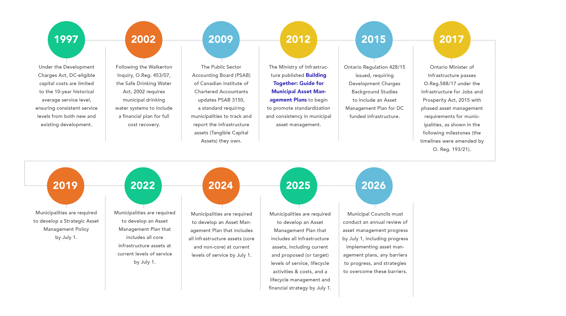
Overview of the Ontario Regulatory Context
A snapshot of the key milestones leading to Ontario's asset management regulation and the current requirements.
Notes:
Speaking note: Mention that both the Strategic Asset Management Policy and the Asset Management Plan(s) need to be updated at least every five years.

Slide 21

Example Case Studies
Notes:
The following section includes 3 fictional case studies, intended to help convey key asset management concepts/scenarios. You can use all 3, or select 1-2 that best meet your needs.

Slide 22
Case Study 1: Moving Beyond “Worst-First” to Risk-Based Decision-Making
Case Study 1: Moving Beyond “Worst-First” to Risk-Based Decision-Making
Bridge A:
Closed due to poor structural condition. It serves a small number of seasonal properties, with low traffic volumes.
Bridge B: In fair condition but deteriorating. It carries a high volume of daily traffic, including school buses, emergency services, and commercial vehicles.
Scenario—The Township of Clearview Hills owns two rural bridges:
Details
Residents near Bridge A have been actively advocating for its replacement, citing inconvenience and longer travel times. The issue has become highly visible, with delegations to Council and local media attention.
At the same time, engineering staff have identified that Bridge B requires rehabilitation within the next 2–3 years. If not addressed, it may require load restrictions or closure, significantly impacting emergency response times, school transportation, and local economic activity.
Notes:
Investment prioritization should be based on multiple factors, not only condition. Focusing only on the worst-condition assets can lead to poor outcomes; risk-based decision-making generates the most value from investments by addressing both service delivery and community safety.

Slide 23
Case Study 1: Moving Beyond “Worst-First” to Risk-Based Decision-Making
Decision Context
A “worst-first” approach would prioritize replacing Bridge A because it is already closed and in the poorest condition. However, a risk-based approach considers:
Likelihood of failure (Bridge B is deteriorating)
Consequences of failure (Bridge B serves critical, high-volume traffic)
Service impact (Bridge A has limited usage; alternatives exist)
Using this lens, staff recommend:
Deferring replacement of Bridge A
Prioritizing rehabilitation of Bridge B to extend its service life and prevent disruption

Slide 24
Case Study 1: Moving Beyond “Worst-First” to Risk-Based Decision-Making
Case Study 1: Moving Beyond “Worst-First” to Risk-Based Decision-Making
Outcome and Key Takeaways
Council ultimately approves the rehabilitation of Bridge B, supported by clear communication about risk, service impact, and long-term value.
Key lessons:
The “worst” asset is not always the highest priority
Risk (likelihood × consequence) provides a more complete basis for decision-making
Proactive investment in critical assets can prevent more costly and disruptive failures
Transparent communication is essential when decisions do not align with vocal public pressure

Slide 25
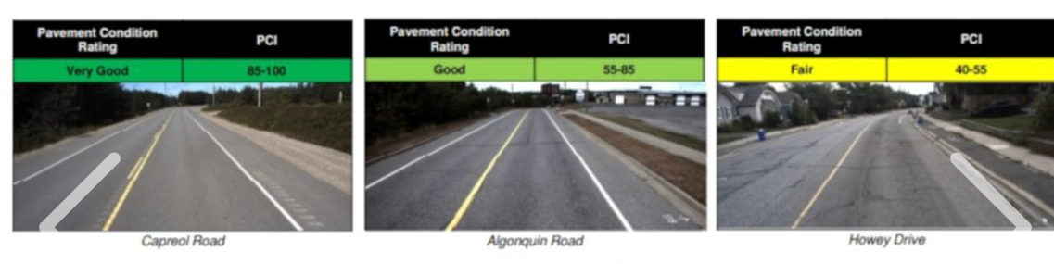
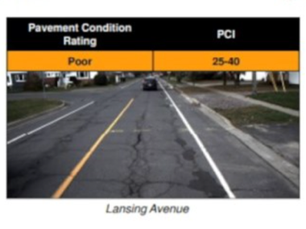
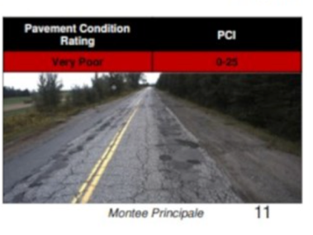
Case Study 2: Finding Cost Savings Through Proactive Lifecycle Management
Case Study 2: Finding Cost Savings Through Proactive Lifecycle Management
Scenario
The Town of Maple Grove manages a network of local roads, many of which are reaching mid-life. Historically, the municipality has taken a reactive approach, addressing roads only when they are in poor condition.
Engineering staff identify an opportunity to implement a preventative maintenance program, including crack sealing and surface treatments, for roads currently in fair condition.
Council is presented with two options:
Continue the current approach, focusing on reconstructing roads once they fail
Invest in preventative maintenance to extend asset life and delay costly reconstruction
Notes:
Investing in timely maintenance and rehabilitation can significantly reduce long-term costs compared to deferring work and relying on full replacement.
Photo from Greater Sudbury (source: https://www.sudbury.com/local-news/greater-sudburys-degrading-roads-underfunded-by-778m-annually-10390031)

Slide 26

Case Study 2: Finding Cost Savings Through Proactive Lifecycle Management
Case Study 2: Finding Cost Savings Through Proactive Lifecycle Management
Decision Context
Initial reactions from Council raise concerns about spending money on roads that “still look fine.”
However, lifecycle analysis shows:
A relatively small investment in maintenance can extend road life by 5–10 years
Deferring maintenance leads to accelerated deterioration and significantly higher reconstruction costs
Over time, the proactive approach allows the municipality to treat more roads within the same budget
Notes:
Investing in timely maintenance and rehabilitation can significantly reduce long-term costs compared to deferring work and relying on full replacement.

Slide 27
Case Study 2: Finding Cost Savings Through Proactive Lifecycle Management
Case Study 2: Finding Cost Savings Through Proactive Lifecycle Management
Outcome and Key Takeaways
Council approves a phased preventative maintenance program. Over several budget cycles, the municipality:
Reduces the number of roads in poor condition
Stabilizes its infrastructure backlog
Achieves better overall network condition at a lower long-term cost
Key Lessons
The lowest upfront cost is not always the lowest long-term cost
Lifecycle management supports more efficient use of limited resources
Proactive strategies can reduce infrastructure deficits over time
Asset management helps shift decision-making from reactive to strategic
Notes:
Investing in timely maintenance and rehabilitation can significantly reduce long-term costs compared to deferring work and relying on full replacement.

Slide 28

Case Study 3: Avoiding Health and Safety Risks Through Timely Investment
Case Study 3: Avoiding Health and Safety Risks Through Timely Investment
Scenario
The Municipality of Lakeshore Valley operates a water distribution system that includes several aging watermains. One section, installed in the 1970s, has experienced an increasing number of breaks over the past five years.
While repairs have been completed as needed, staff note that:
Break frequency is increasing
The watermain serves a hospital, school, and dense residential area
A major failure could result in prolonged service disruption and potential
public health concerns
At the same time, other capital pressures compete for funding, including facility upgrades and road improvements.
Notes:
Asset management helps identify and mitigate risks to health and safety, enabling municipalities to act before failures occur.

Slide 29

Case Study 3: Avoiding Health and Safety Risks Through Timely Investment
Case Study 3: Avoiding Health and Safety Risks Through Timely Investment
Decision Context
Council must decide whether to:
Continue reactive repairs as breaks occur
Proactively replace the high-risk watermain segment
Asset management analysis highlights:
High consequence of failure (critical services, vulnerable populations)
Increasing likelihood of failure based on asset condition and break history
Potential costs associated with emergency response, service disruption, and reputational impact
Notes:
Asset management helps identify and mitigate risks to health and safety, enabling municipalities to act before failures occur.

Slide 30
Case Study 3: Avoiding Health and Safety Risks Through Timely Investment
Case Study 3: Avoiding Health and Safety Risks Through Timely Investment
Outcome and Key Takeaways
Council approves the proactive replacement of the watermain segment, prioritizing it over lower-risk projects.
As a result, the municipality:
Reduces the risk of major service disruption
Improves reliability for critical community services
Avoids higher emergency repair costs and potential liability
Key Lessons
Not all risks are visible—data and trends are critical for early identification
Health and safety risks should be a top priority in decision-making
Proactive investment can prevent emergencies and protect vulnerable populations
Asset management supports defensible, transparent decisions in complex situations
Notes:
Asset management helps identify and mitigate risks to health and safety, enabling municipalities to act before failures occur.

Slide 31

Working Slides for Municipal Staff

Slide 32
Tips for Developing Your Own Case Study
Working Slides for Municipal Staff
Building a Strong Asset Management Case Study:
Start with a clear problem or decision point
Connect to service impacts (what matters to residents)
Show how asset management informed the decision
Compare before and after outcomes
Highlight trade-offs and alternatives considered
Emphasize risk and consequences

Slide 33
Tips for Developing Your Own Case Study
Working Slides for Municipal Staff
Making It Compelling for Council:
Quantify costs, savings, and service improvements
Link to long-term financial sustainability
Keep it clear, concise, and non-technical
Use local, relatable examples and visuals
Be transparent about challenges and limitations
End with a clear key takeaway for Council

Slide 34
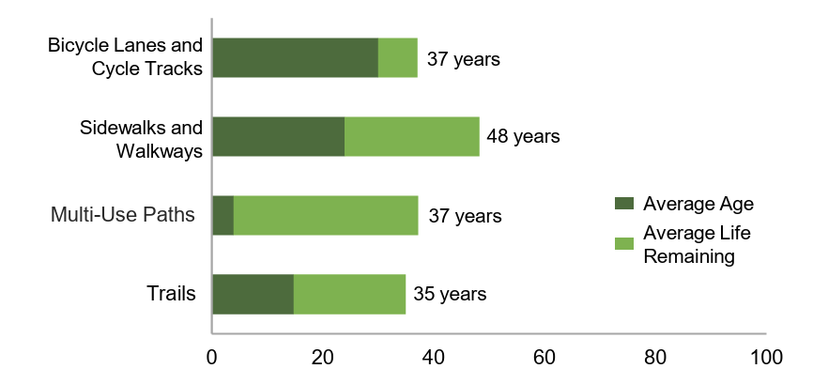
State of Infrastructure – Template (by Service Area or Asset Class)
State of Infrastructure – Template (by Service Area or Asset Class)
1-2 sentences about the service area
Replacement Value: [insert total $ value]
Asset portfolio overview: (table to complete)
Asset | Quantity of Assets (# or Km) | Replacement Value | Average Age and Remaining Service Life | Overall Condition (status or letter grade)
Average age and
expected service life
Example from City of Richmond Hill
Notes:
Duplicate these slides as needed to share high-level info at the level of detail that is appropriate for your municipality.
If time permits (or for municipalities with fewer departments / service areas) providing a snapshot for each service area can be a very useful introduction for Council.
In a municipalities with many service areas (often larger municipalities), it might make sense to present portfolio level info here or showcase certain service areas (depending on current funding priorities, or on the theme of the meeting). If you have enough time, you can include snapshots for each.
Image source:
City of Richmond Hill: 2023 State of Infrastructure (https://www.richmondhill.ca/en/shared-content/resources/documents/2023-State-of-Infrastructure.pdf)

Slide 35
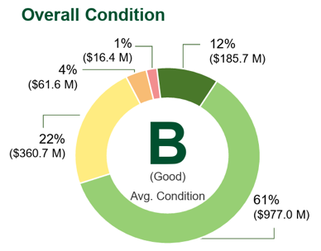
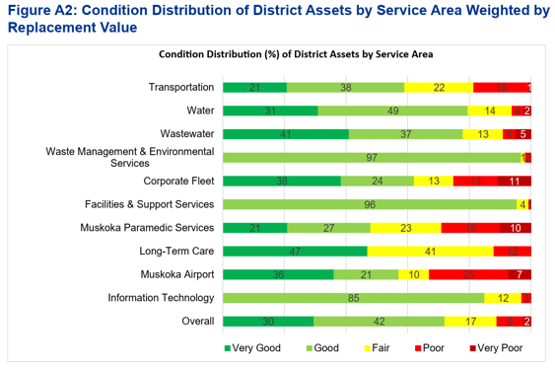
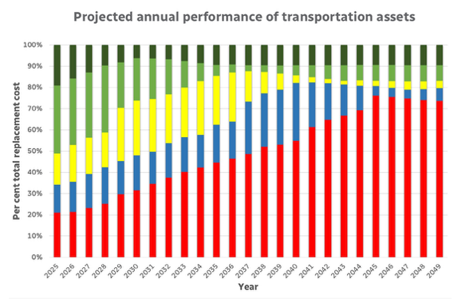
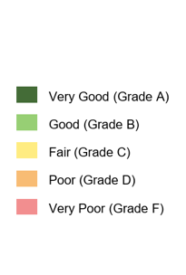
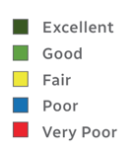
State of Infrastructure – Template (by Service Area or Asset Class)
State of Infrastructure – Template (by Service Area or Asset Class)
Options to show conditions:
Option 1: City of Richmond Hill
Option 2: Regional Municipality of Muskoka
Option 3: City of Waterloo
Notes:
Duplicate these slides as needed to share high-level info at the level of detail that is appropriate for your municipality.
If time permits (or for municipalities with fewer departments / service areas) providing a snapshot for each service area can be a very useful introduction for Council.
In a municipalities with many service areas (often larger municipalities), it might make sense to present portfolio level info here or showcase certain service areas (depending on current funding priorities, or on the theme of the meeting). If you have enough time, you can include snapshots for each.
Image sources:
Option 1: City of Richmond Hill: 2023 State of Infrastructure (https://www.richmondhill.ca/en/shared-content/resources/documents/2023-State-of-Infrastructure.pdf)
Option 2: The District of Muskoka: 2024 Asset Management Plan – State of Infrastructure Report (https://www.muskoka.on.ca/en/finance-and-administration/resources/Documents/FCS-6-2024-3---2024-AMP-State-of-Infrastructure-Rpt_Final.pdf)
Option 3: The City of Waterloo, asset class report cards (https://www.waterloo.ca/council-and-city-administration/budget-and-financial-reports/asset-management/) (Transportation example: https://www.waterloo.ca/media/jrwkigv4/transportation_2025assetmgmt_reportcard_85x11_aoda-compliant.pdf)

Slide 36
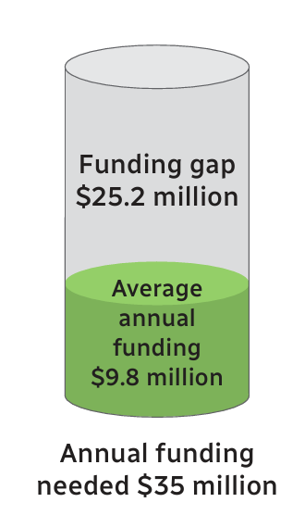
State of Infrastructure – Template (by Service Area or Asset Class)
Working Slides for Municipal Staff
Optional elements:
Data maturity level: (high, medium, low)
  Consider adding an explanation, especially if maturity is medium or low
Funding needed to meet target performance vs available funding. Summary of funding gap
List of key projects
Featured project/story (to make the data more relatable)
Example of funding gap visualization (City of Waterloo)
Notes:
Image source:
The City of Waterloo, asset class report cards (https://www.waterloo.ca/council-and-city-administration/budget-and-financial-reports/asset-management/) (Transportation example: https://www.waterloo.ca/media/jrwkigv4/transportation_2025assetmgmt_reportcard_85x11_aoda-compliant.pdf)

Slide 37








